Slide 1



Inga Herrmann
Shephard of Carbon Footprint WG/ UEIL Sustainability Committee
Sales Manager & Sustainability Lead / Ergon International Inc.
European View on Sustainability in the Lubricant Industry

Slide 2
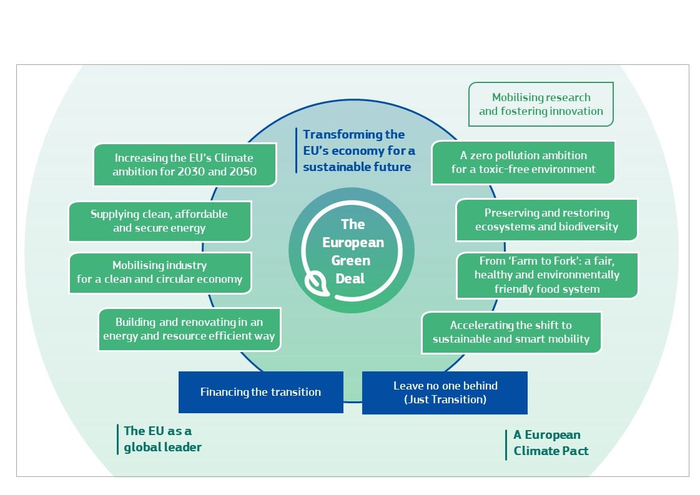
European Green Deal: Expectations towards our industry
Affecting our markets
Affecting our products
Emission reduction and decarbornization
Ecodesign for sustainable Products Regulation
Emission reduction and decarbornization
Ecodesign for sustainable Products Regulation
EU Emission Trading System ETS
Chemicals Strategy for Sustainability towards a toxic free environment
Carbon Border Adjustment CBAM
Safe and Sustainable by Design Framework
Circular Economy
Green Claims Directive
Green Claims Directive
Affecting our customers and their business!
Image source: European Commission / Communication from the commission / The European Green Deal
Notes:
Source: https://eur-lex.europa.eu/legal-content/EN/TXT/HTML/?uri=CELEX:52019DC0640

Slide 3
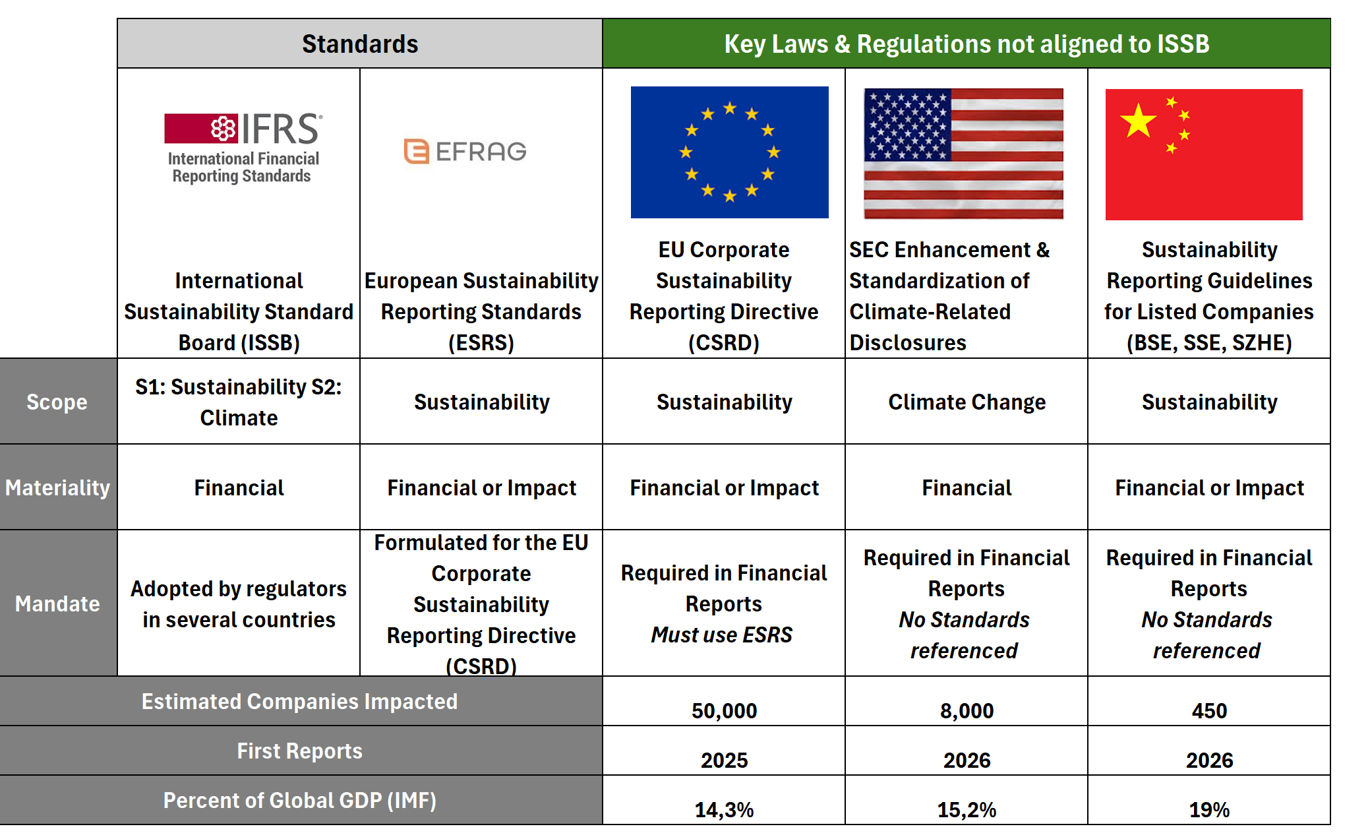
Global ESG Disclosure Landscape Takes Shape
Notes:
The US Securities and Exchange Commission (SEC) has adopted new rules requiring mandatory climate-related disclosures from certain companies. These rules have been compared to existing frameworks from the International Financial Reporting Standards (IFRS) and the European Union's Corporate Sustainability Reporting Directive (CSRD).
On March 6, 2024, the SEC adopted new climate disclosure rules. These rules require companies to publish information that describes the climate-related risks that are reasonably likely to have a material impact on a company's business or consolidated financial statements.
Here's a quick comparison of the three:
* Created by: The SEC's rules were created by the US regulatory body, IFRS standards are developed by the International Financial Reporting Standards Foundation, and CSRD by the European Financial Reporting Advisory Group (EFRAG).
* Region: SEC applies to US registered companies, IFRS is intended for worldwide adoption (but depends on individual jurisdictions), and CSRD applies to EU operations/revenue or certain non-EU entities.
* Scope: SEC focuses on climate-related disclosures, IFRS and CSRD are broader, covering environmental, social, and governance (ESG) factors.
* For whom: SEC applies to large accelerated filers for now, with smaller companies phased in between 2026-2028. IFRS and CSRD can apply to public and private entities depending on the specific jurisdiction.
* Materiality: SEC uses single financial materiality, IFRS uses single financial materiality with specific disclosures required based on materiality, and CSRD uses double materiality.
* Scope emissions: All three require disclosure of Scope 1 and 2 emissions, but only IFRS and CSRD require Scope 3 disclosures.
* TCFD Alignment: All three frameworks are broadly aligned with the recommendations of the Task Force on Climate-Related Financial Disclosures (TCFD), but structured differently.
* # of filers: The SEC rule applies to a smaller number of filers compared to IFRS and CSRD.
* Scenario analysis: Only IFRS requires scenario analysis on topics deemed material.
Overall, the SEC's new rules represent a significant step forward for climate-related disclosures in the US, but they are not as comprehensive as the IFRS and CSRD frameworks. Companies that are subject to multiple jurisdictions will need to comply with the most stringent requirements.

Slide 4


Need for an Industry Agreed Methodology for Carbon Footprint Calculation
No agreed methodology
Results cannot be compared
International Standards
Allows for methodological choices to be made
Industry Best Practice & International Standards
Provides recommendations for methodological choices and potential data sources.
Product Category Rules & International Standards
Mandates methodological choices and data sources.
Increases possibility for making a comparison on equal footing
For example, ISO 14067
For example, API TR 1533
Notes:
Regulators, Consumers and Equipment Manufacturers require the submission of PCF for products sold. Our products’ PCF becomes part of our customers’ PCF.
ISO 14067 is not precise enough to be able to assure compatibility of PCF-calculations in a specific sector like the lubricants industry
Current status: Data and figures from different sources are inherently not comparable
Industry is on a journey to define rules and guidelines for calculating carbon footprints of lubricant products.
Multiple lubricant industry organizations are striving to define industry best practice with their members (API, ATIEL, UEIL, VSI) & ALIA is participating

Slide 5




PCF – Relevance for our industry
Why are methodologies needed and how do they contribute to transparency ?
No methodology
Even with greatest care applied, results cannot be compared, thus might be meaningless for downstream partners in the value chain
Moreover, results without transparency how they were calculated are meaningless at all
ISO 14067
Gives a framework in which to operate
Defines mandatory elements to consider
Defines minimum requirements for reporting
BUT: is not a detailed How-to-guide; requires manifold decisions to be taken leading to non-comparable results
Sector-specific methodology based on ISO14067
Addresses all requirements of ISO14067
Contains guidance for methdological choices which ISO left open to decide
Defines categories for data sources and quality indicators
Can be the basis to compare PCF-values if calculated under the same, certified methodology
Product Category Rule based on ISO14067
Addresses all requirements of ISO14067
Mandates methodological choices and data sources for a specific product group
Required for complex processes/sectors for which a methodology would still leave open too many options
→ might be necessary for the refinery sector in future

Slide 6

Development of a sector specific PCF
Joint UEIL/ATIEL – PCF – Task Force
WHY:
Regulators, Consumers and Equipment Manufacturers require the submission of PCF for products sold. Our products’ PCF becomes part of our customers’ PCF.
ISO 14067 is not precise enough to assure compatibility of PCF-calculations in a specific sector
Need for harmonization and clear definition how to calculate and REPORT the PCF for lubricants
HOW:
UEIL and ATIEL enable for harmonization and clear definition how to calculate the PCF for lubricants, compatible with TfS (Together for Sustainability) and API
UEIL/ATIEL PCF-Task Force started Jan. 2023
UEIL/ATIEL PCF Methodology
WHAT:
UEIL/ATIEL-Methodology Rev. 0 published Oct. 6th 2023
TÜV-Rheinland 3rd party review led to Rev. 1, published Nov. 30th 2023
BASIS:
ISO 14067:2018
GHG Protocol Product Standard
GOAL:
harmonize PCF-calculations of lubricants
and other specialties
achieve alignment in the lubricants industry,
resulting in transparency, comparability, and
acceptability of PCF calculations
intended audience is internal and external
stakeholders globally, for instance:
Customers, Suppliers, Lubricant industry,
Legislators, Investors, LCA/PCF auditors
and practitioners
Notes:
WHY:
Regulators, Consumers and Equipment Manufacturers require the submission of PCF for products sold. Our products’ PCF becomes part of our customers’ PCF.
ISO 14067 is not precise enough to be able to assure compatibility of PCF-calculations in a specific sector like the lubricants industry
There is a need for harmonization and clear definition how to calculate and REPORT the PCF for lubricants
Parallel activities in the wider industry
“Together for Sustainability” published a PCF-methodology for chemicals – very detailed but not fully applicable for the lubricants sector since different decisions are required for manufacturing lubricants and greases compared to chemicals
API has published Technical Report 1533 – leaving many options
HOW:
UEIL and ATIEL enable for harmonization and clear definition how to calculate the PCF for lubricants, compatible with TfS and API:
Chemical industry (TfS): methodology has been endorsed by ATC representing the additive suppliers
API has published a Technical Report which is endorsed by the US base oil suppliers
UEIL/ATIEL PCF-Task Force started Jan. 2023
6 months - 1 working group – 10 members (ATIEL, ELGI, GEIR, UEIL, UNITI/VSI, TfS) – 1 consultant – 4 personal meetings - 17 online meetings to develop the draft ready for consultation phase June/July 2023 – feedback considered from many associations
WHAT:
UEIL/ATIEL-Methodology Rev. 0 published Oct. 6th 2023
TÜV-Rheinland 3rd party review led to Rev. 1, published Nov. 30th 2023
Joint UEIL/ATIEL PCF Methodology
Basis:
ISO 14067:2018
GHG Protocol Product Standard
Goal:
to harmonize PCF-calculations of lubricants and other specialities across the value chain
achieving alignment in the lubricants industry, resulting in transparency, comparability, and acceptability of PCF calculations for their stakeholders
intended audience is internal and external stakeholders globally, being, for instance: Customers, Suppliers, Lubricant industry, Legislators, Investors, LCA/PCF auditors and practitioners

Slide 7
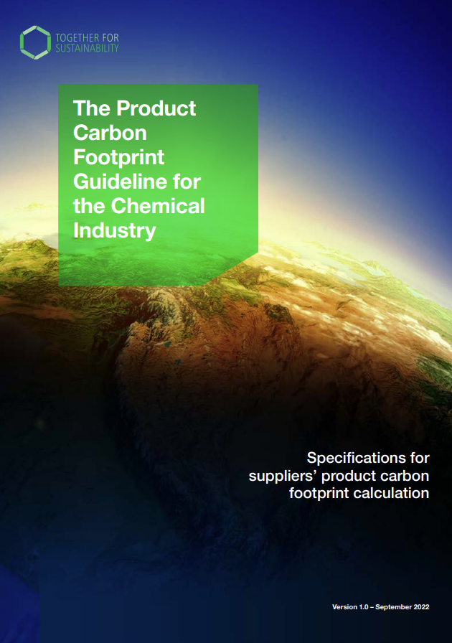

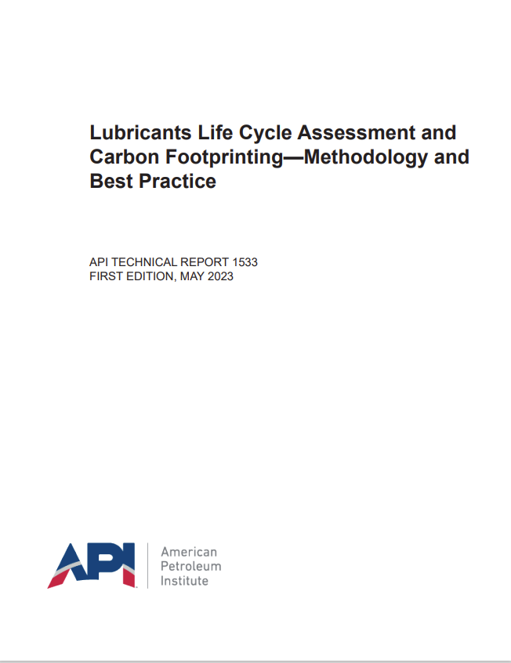
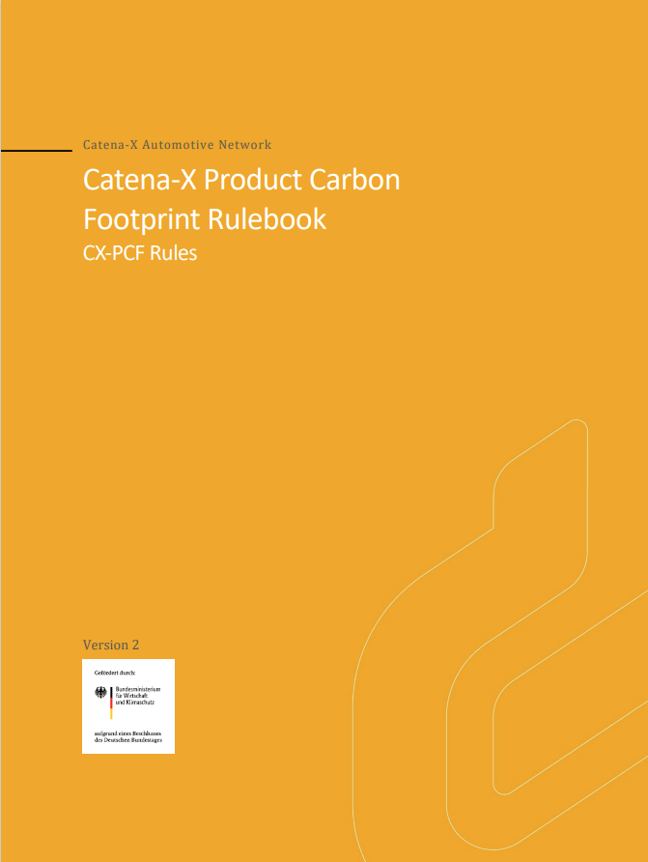
Product Carbon Footprint
and Life Cycle Assessment
Product Carbon Footprint Guideline for the Chemical Industry (TfS)
Product Carbon Footprint methodology for the Lubricants Industry (UEIL/ATIEL)
Lubricants Life Cycle Assessment and Carbon Footprinting – Methodology and Best Practice (API)
CatenaX Product Carbon Footprint Rulebook (Automotive Industry)
Cradle to gate
Cradle to gate
Cradle to grave

Slide 8





Methodologies - We are not alone…
Together for Sustainability
Chemical Industry
UEIL/ATIEL
Lubricants Industry
American Petroleum Institute
- Oil & Gas Industry
Document: The PCF Guideline for the Chemical Industry
Published: November 2022
Scope:
Methodology
Product Carbon Footprint for chemicals
Cradle-to-Gate (suppliers exit gate)
3rd party reviewed: TÜV Rheinland, Mar. 2023
Endorsed by: ATC, APAG (oleochemical industry)
Document: Methodology for Product Carbon Footprint Calculations for Lubricants and other Specialities
Published: October 2023
Scope:
Methodology
PCF for Lubricants (incl. Greases) and other specialities
Cradle-to-Gate (lube manufacturers exit gate)
3rd party reviewed: TÜV Rheinland, Nov. 2023
Document: API TR1533
Published: May 2023
Scope:
Technical Guidance/Best Practice Document
PCF / LCA
Various: Cradle-to-Grave/EoL
Rev. 2.0 ready for feedback since 10/23
Catena-X
Automotive Industry
MoU between TfS and CatenaX, CatenaX Vision-goals
8

Slide 9
Joint UEIL/ATIEL PCF Methodology
Data Categories:
4 data categories exist for collecting foreground and background data
For the foreground system, primary data shall be used
For each data source, data quality has to be assessed
Note: Primary data not necessarily must have the highest quality or precision!
PRIMARY
DATA
PRIMARY DATA
SPECIFIC
SECONDARY DATA
SPECIFIC
SECONDARY
DATA
PRODUCT
CARBON
FOOTPRINT
ESTIMATED
DATA
PROXY
DATA
PROXY
DATA
ESTIMATED
DATA

Slide 10

Re-refined base oils can drive circularity and offer further benefits with no compromise on quality and performance
Waste Reduction and
Conservation of Resources
Meet Regulatory Requirements
Used Oil regulations are becomingly more stringent, favouring recycling over use as fuels. Potential regulations mandating use of RRBO in lubricants, eg Turkey, India
Provides a sustainable outlet for used oils and preserves non-renewable resources such as crude. Helps to reduce Waste
Lower GHG Emissions
Supply Security
Typically, lower carbon emissions across the product lifecycle compared to products made with virgin fossil-based base oils of the same API group
Sustainable alternate source to virgin base oil, Provide more flexibility in formulation and reduce exposure to fluctuation in crude oil supply and pricing
Reputation and Brand
Demonstrate your commitment to a cleaner environment though recycling and proper waste management.
Image source: Shell Research

Slide 11
We are convinced that it is in the best interest of the industry that we do not COMPETE on methodologies but rather accept that different sectors might need slightly different approaches.
Harmonization and Endorsement are key!

Slide 12



Where do we go from here?
Cooperation
UEIL/ATIEL are committed to align with lubricant associations around the globe on PCF-Methodology, but not limited to!
We would welcome a PCR for refinery products
We invite other lubricant associations to make use of our PCF-methodology – it is not applicable only for Europe!
Alignment
UEIL/ATIEL have analyzed and deliberately accepted methodologies from
- TfS for Additives and Chemicals
- API for Baseoils
We are convinced that differences should not divide us!
We strive for dialogue with other leading sectoral PCF-methodologies: TfS, Catena X-Rulebook
Improvement
UEIL/ATIEL are committed to further develop the methodology and adapt to the trends in the industry
We want to support our members with helpful tools and guidance on how to get started
We scan the market for recommended data sources specific for the lubricant industry
Next focus
GHG missions along the Lubricant Value Chain
Avoided Emissions

Slide 13
















Global Coordination and Collaboration
International Lubricants Sustainability Liaison Group
Japan and China are not represented, for example:
Shared Priorities
Product Carbon Footprint
  alignment / harmonisation with TfS and CatenaX
Avoided Emissions
  European Commission
  (Green Claims Substantiation Directive)
  WBCSD Best Practice
End-of-Life

Slide 14

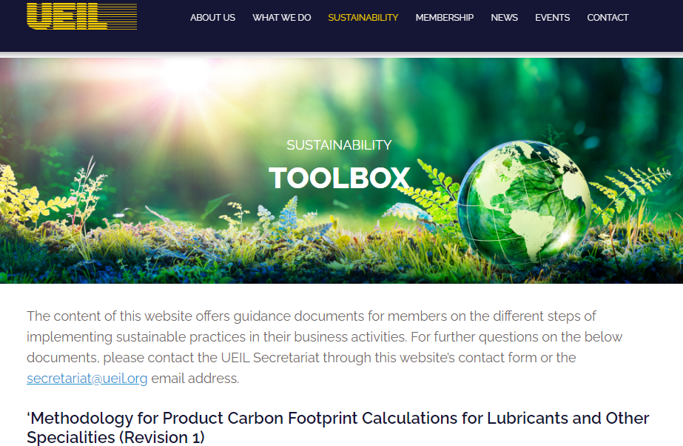
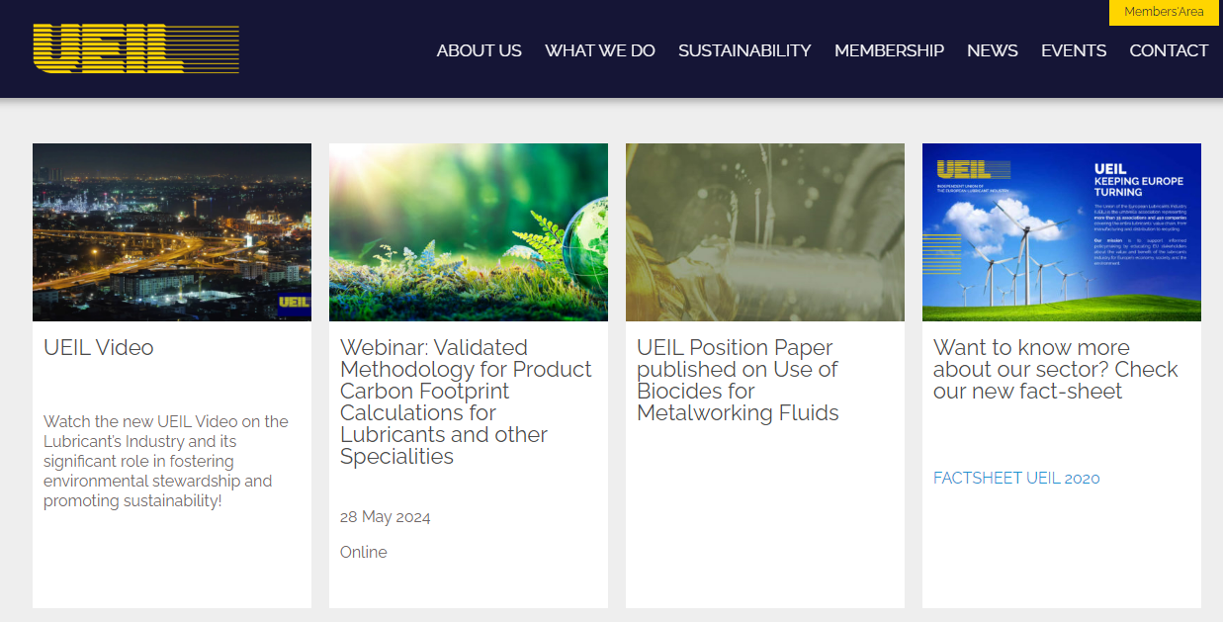
Feel invited
To make use of the PCF
Methodology – for free!
Download from www.ueil.org
To take part in our upcoming webinar Validated Methodology for Product Carbon Footprint Calculations for Lubricants and other Specialities
on May 28th
sign up on www.ueil.org
Thank you!
Notes:
https://www.ueil.org/wp-content/uploads/2023/12/UEIL_ATIEL_PCF-Methodology_Rev-1.pdf

Slide 15
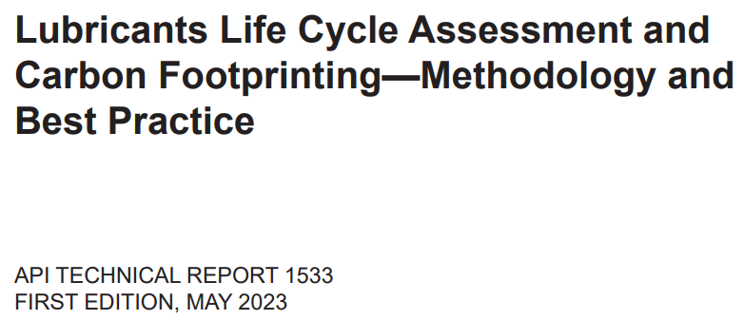




Summary: Development of Life Cycle Analyses (LCA) methods and Best Practice
High-level standards
Industry Best Practice
Three relevant methodologies have now been published:
ISO 14040/14044 – Principles, requirements and characteristics of LCA
ISO 14067 – GHGs - carbon footprint of products
– requirements and guidelines for quantification
Product standard
PAS 2050
Notes:
LCA or “cradle-to-grave analysis” emerged as a formalized process to comparatively assess technology or product choices
Increased use (and controversy) led to a push for standardization of the method

