Slide 1
Union of the
EUROPEAN LUBRICANTS INDUSTRY
Union Européenne de l’Industrie des Lubrifiants
Calculating Carbon Footprints
4th May 2023
27th ICIS World Base Oils and Lubricants Conference
WWW.UEIL.ORG

Slide 2
Agenda
Lubricants: An Asset to Society and Economy
Changing Regulatory and Customer Landscape
UEIL Sustainability Committee and Working Groups
Corporate Carbon Footprint
Product Carbon Footprint
Summary
john_eastwood@cargill.com
https://www.ueil.org/sustainability/

Slide 3
The lubricants industry is a valuable asset to society and economy in Europe and beyond…
We keep the world turning
We drive growth and innovation
We care about our impact
Definition: Lubricants created by innovative businesses enabling the use of safe, resource saving technologies and processes which reduce the burden on the planet, local environments and benefit people and society.

Slide 4
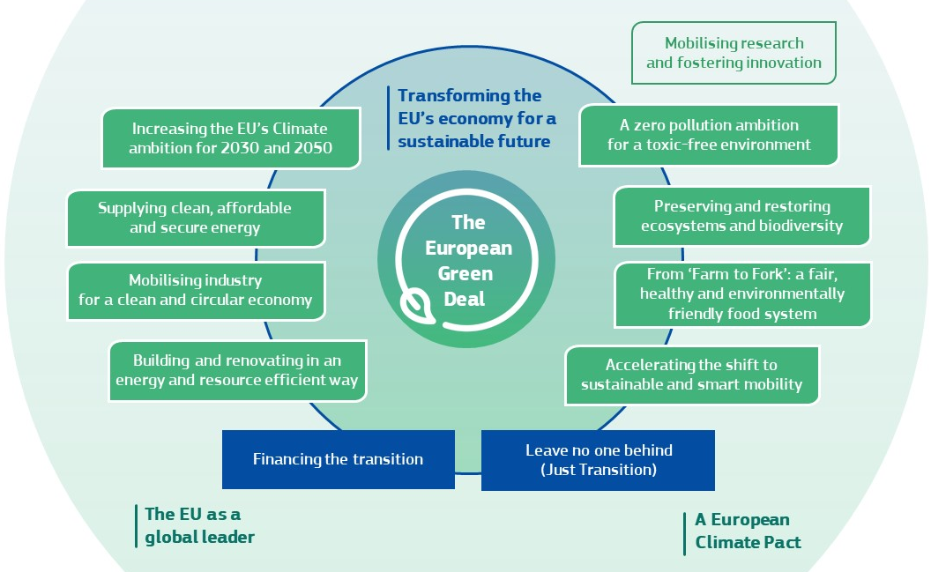
Changing Regulatory Landscape The European Green Deal

Slide 5
Changing Regulatory and Customer Landscape Growing customer and market needs for sustainable solutions
Increasing legislative requirements
EU Green Deal
Chemicals Strategy for Sustainability
Sustainable Product Initiative / Ecodesign for Sustainable Product Regulation
Safe and Sustainable by Design
Green Claims Directive
Transition to Circular Economy
REACH revision and other global chemical regulations
Global emission reduction climate targets
Conscious consumers
Growing population that consciously wants to purchase sustainable products
Brand-owners setting sustainability targets
Pushing demand for sustainable and innovative solutions
Supply chain transparency and certification
Source: With thanks to CEFIC

Slide 6
Addressing the Changing Regulatory Environment
UEIL SC + UEIL HSE Working in Partnership
Carbon Footprint WG
Downstream
WG
UEIL Sustainability Committee
Communications WG
REACH
UEIL Health, Safety and Environment

Slide 7
Carbon Footprint Scopes in the Lubricant Industry Partnering with the complete value chain
ATC, ATIEL, GEIR, APAG
EU-level: UEIL, ATIEL, ELGI International Level: API, ILMA, ALIA, ALA, NLGI
OEMs
GEIR
Associations
Exploration / Mining / Farming / Tier-n Pre-Suppliers
Min B/O- Manufacturers
Lubricant Developing and Manufacturing Companies
Lubricant User / Use Phase
Used Oil Collectors / Recyclers
Syn. & Veg B/O- Manufacturers
Value Chain Partners
Re-refiners
Lubricant Blenders / Marketers
Additive Manufacturers
Specialty Manufacturers
Value Chain
Refining / Processing
End-of-Life / Value Leakage
Exploration
End-of-Life
Exploration
Refining / Processing
Design/R&D
Design/R&D
Manufacturing
Manufacturing
Distribution / Retail
Distribution / Retail
Usage / Consumption
Use Phase
Cradle-to-Gate*
Gate-to-Gate*
Emission Scopes
Cradle-to-Gate**
Cradle-to-Grave (or Cradle)
Carbon Footprint Working Group
Downstream Working Group
UEIL WGs
Communications Working Group
* Gate-to-Gate scope includes GHG-Protocol Scope 1, 2 & selected Scope 3-emissions (Water, Waste, Business Travel, Commuting) for all units/companies in a lubricant company
** Cradle-to-Gate scope includes Gate-to-Gate Scope PLUS purchased raw materials, goods, packaging etc.

Slide 8
Corporate Carbon Footprint

Slide 9
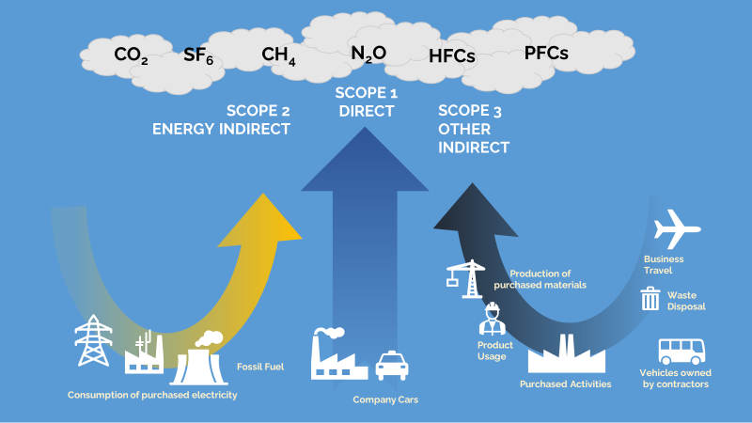
Product Carbon Footprint to Corporate Carbon Footprint
Corporate Carbon Footprint is the sum of all emissions associated with an organisation
Raw material PCF can typically account for 70 – 80% of an organisations corporate carbon footprint
Scope 1 (Direct emissions from owned or controlled sources) | Scope 2 (Energy indirect emissions from the generation of purchased energy consumed) | Scope 3 (Other Indirect)
Fuel combustion Company vehicles Fugitive emissions | Purchased electricity, heat, steam and cooling | 3.1 Purchased goods and services 3.2 Capital Goods … 3.4/9 Transportation & distribution (up- and down-stream) 3.5 Waste disposal 3.6 Business Travel … 3.11 Use of sold products 3.12 End of Life Treatment …
Source: Carbon Trust

Slide 10
Corporate Carbon Footprint Toolbox
‘Only by understanding where carbon emissions come from can lubricant blenders put in place a well-defined strategy, identify key performance indicators and take action to reduce their overall carbon footprint.’
Toolbox contains:
Guidance notes to explain what data you need and where to find it
A “fictitious company” to use as an example and guide, to help you think about your own emissions
A spreadsheet with clear places to enter your data
Formulae to automatically calculate your Scope 1, 2 and 3 emissions from your data
https://www.linkedin.com/video/event/urn:li:ugcPost:6976523372180480000/

Slide 11
Product Carbon Footprint

Slide 12
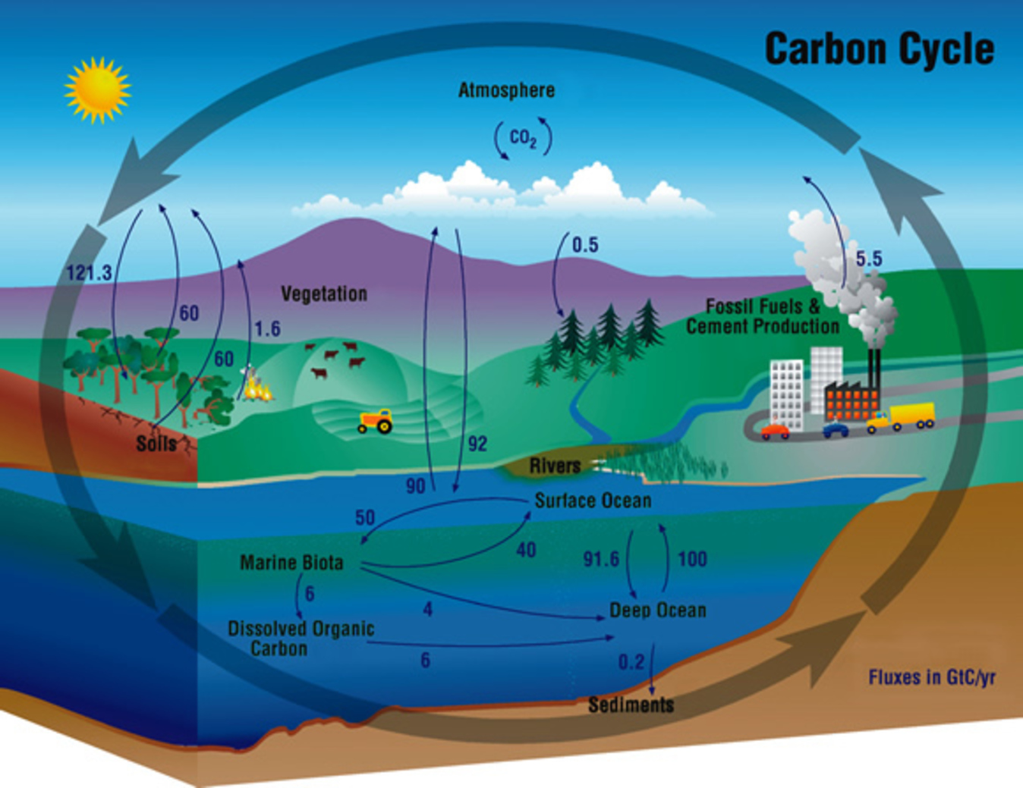
The Carbon Cycle
Fossil derived fuels and lubricants, which are not recycled will result in a net increase in CO₂ in the atmosphere (cradle – to - end of life)
Biobased derived fuels and lubricants, which are not recycled can result in a near net-zero contribution of CO₂ in the atmosphere (cradle – to – end of life)
Image: World Economic Forum (weforum.org)

Slide 13
Visualising Carbon Footprint of a ‘Substance/Mixture’ - Upstream
Stakeholders down the value chain inherit the carbon from their suppliers
Transport, distribution & packaging
SUBSTANCE / MIXTURE
e.g. base oils, additives
RAW MATERIALS
Carbon footprint of a single raw material received by user
Infrastructure
Carbon inherited from suppliers
Heat
Electricity
Auxiliary materials (catalysts, solvents…)

Slide 14
Visualising Carbon Footprint of a ‘Lubricant’ - Downstream
Carbon footprint of a compounded lubricant or grease (base oils, additives, processing)
BO
Loss in Use
AO
Lubricant (bulk product)
Transport, distribution & packaging
VM
End-of-life
AC
Use Phase
AW
etc
Infrastructure
The lubricant becomes part of the carbon footprint of downstream customers
EOL:
The lubricant is either incinerated, resulting in value leakage from the value chain by emitting carbon to the atmosphere or recycled, preserving the carbon content for a second life, resulting in minimal emissions to atmosphere
Heat
Electricity
Waste
Scope for UEIL/ATIEL-PCF-Methodology

Slide 15
Transparency and Traceability along the value chain to target net zero emissions…
Emission Data
Lubricant
Blender
Emission Data
Customer
OEM
Emission Data
End of Life
Supplier
UPSTREAM
DOWNSTREAM
ISO 14067 is not precise enough to be able to assure comparability of PCF-calculations in a specific sector like the lubricants industry
Therefore there is a need for harmonization and clear definition how to calculate the PCF for lubricants

Slide 16
Product Carbon Footprint for Lubricants
Together for Sustainability
- Chemical Industry
UEIL/ATIEL
- Lubricants Industry
American Petroleum Institute
- Oil & Gas Industry
Document: The PCF Guideline for the Chemical Industry
Published: November 2022
Scope:
Methodology
Product Carbon Footprint
Cradle-to-Gate (suppliers exit gate)
Under Review by:
Fuel Additive and Lubricant Additives → ATC
Oleochemical and Allied Products industry → APAG
MoU between TfS and CatenaX
CatenaX Vision-goals
Document: [draft]
To be Published: 2. HY 2023
Scope:
Methodology
PCF for Lubricants (incl. Greases) and other specialities
Cradle-to-Gate (lube manufacturers exit gate)
Status:
Work in progress
Addresses EU requirements
Target: harmonise with existing methodologies (TfS/API)
Document: API 1533
Published: 2nd May 2023
Scope:
Technical Guidance Document
PCF / LCA
Cradle-to-Grave/EoL
International ballot phase concluded in February 2023

Slide 17
UEIL / ATIEL PCF for Lubricants Timeline
Cradle-to-Gate (lubricant / grease / speciality manufacturers exit gate)
Formation of Cross-Industry WG (December 20th 2022)
Draft Methodology (June 2023)
Revision Phase (September 2023)
Consultation Phase
(July 2023)
Publication
(H2 2023)
Communication and Training
UEIL
ATIEL
GEIR
VSI / UNITI
ELGI
Advisor
Carbon Minds (Consultant)
Joint UEIL / ATIEL Press Release
(February 7th)
Progress Report
(March 27th)

Slide 18
Illustration of Raw Material PCF (kgCO_{2e} / Kg Product)
Cradle – to – (Producer’s Exit) Gate
Ingredient 1
2,17
2,17
Product
Ing 3
Electricity 0.31
Gas 0.53
PCF excluding biogenic emissions and removals
2.17 kgCO2e/kg
+
0
=
Petrochemical ester example
Ing 2
Auxiliary materials 0.064
PCF_{fossil}
PCF_{biogenic}
Σ PCF
Raw materials PCF_{fossil} = +1.27
Raw materials PCF_{biobased + biogenic removals} = 0
Ingredient 1 (biobased)
2,17
Ing 3
Electricity 0.31
Gas 0.53
PCF including biogenic emissions and removals
-0.9 kgCO2e/kg
+
-3,07
=
-0,9
Biobased ester example
Ing 2
Auxiliary materials 0.064
Product
Raw materials PCF_{fossil}= +1.27
PCF_{fossil}
PCF_{biogenic}
Σ PCF
Raw materials PCF_{biobased + biogenic removals} = -3.07

Slide 19
Illustration of Raw Material PCF (kgCO_{2e} / Kg Product) with Land Use Change
Cradle – to – (Producer’s Exit) Gate
Ingredient 1 (biobased)
2,17
Ing 3
Electricity 0.31
Gas 0.53
PCF including biogenic emissions and removals
-0.9 kgCO2e/kg
+
-3,07
=
-0,9
Biobased ester example
No adverse Land Use Change
Ing 2
Auxiliary materials 0.064
Product
Raw materials PCF_{fossil}= 1.27
PCF_{fossil}
PCF_{biogenic}
Σ PCF
Raw materials PCF_{biobased + biogenic removals} = -3.07
Biobased carbon does not necessarily equate to lower PCF when land use is considered…
+5
+ 4.1
LuC
Ingredient 1 (biobased)
2,17
Product
PCF including biogenic emissions, removals and dLuC
+ 4.1 kgCO2e/kg
Ing 3
Electricity 0.31
Gas 0.53
+
+
-3,07
=
Biobased ester example + Direct Land Use Change
Ing 2
Auxiliary materials 0.064
Raw materials PCF_{fossil}= +1.27
PCF_{fossil}
PCF_{biogenic}
PCF_{dLuC}
Σ PCF
Raw materials PCF_{biogenic} = -3.07 (negative → emission removal)
Direct Land Use Change PCF_{dLuC} = +5.00
Biobased is not considered as part of PEF & SBTi approach – no incentive to change to biobased !

Slide 20
Conclusion PCF
ISO 14067 is not precise enough to be able to assure comparability of PCF-calculations in a specific sector like the lubricants industry
There is a need for harmonization and clear definition how to calculate the PCF for lubricants
The Chemical industry has published TfS methodology and API has published a Technical Report; together we strive for a PCF-methodology for lubricants which is compatible, but narrowing options down as needed for lubricants
When defining PCF-methodology in detail, regulatory obstacles become visible that might hinder or slow down the lubricants industry in transition to Net Zero Emissions:
Exclusion of accounting of biobased uptakes within PCF by current PEF and SBTi-rules does not create an incentive to transition to more biobased feedstock
However, biobased raw materials are one of the key measures to de-fossilize the lubricants industry

Slide 21
Summary
We are in a dynamic period regarding sustainability
Consumer and Customer pull for more ‘sustainable’ products
Regulatory push
Sustainability journey will not stop at carbon footprint, the EU Green Deal means we are in for a long period of activity to become ever-more sustainable and transparent
Continued collaboration within the entire lubricants value chain is fundamental to becoming more ‘sustainable’
The Lubricant industry is in a unique position:
We already provide solutions that drive improvements in energy efficiency and support the trend towards renewable energy, and we will enable the transition to net-zero carbon emissions
But we also recognise that we must continually adapt and innovate, and increasingly move towards a larger circular economy

Slide 22
Union of the European Lubricants Industry
THANK YOU!
Avenue des Arts 46 - 1000 Brussels
T +32 2 504 90 03 - secretariat@ueil.org
22

