Slide 1
The European Green Deal
UEIL 2021 Virtual Congress “From business resilience to sustainable growth – Re-imagining the future of the lubricants industry “
20 October 2021
DG Environment, Unit B3 – Enrique García John

Slide 2











CLIMATE
PACT AND CLIMATE
LAW
PROMOTING
CLEAN
ENERGY
INVESTING IN MORE
SUSTAINABLE,
SMARTER MOBILITY
PROTECTING NATURE
MOBILISING INDUSTRY
FOR A CLEAN AND
CIRCULAR ECONOMY
The European
Green Deal
FROM FARM
TO FORK
ELIMINATING
POLLUTION
LEADING THE
GREEN CHANGE
GLOBALLY
ENSURING
A JUST TRANSITION
FOR ALL
MAKING
HOMES ENERGY EFFICIENT
FINANCING
GREEN
PROJECTS
Notes:
Building blocks of the European Green Deal
CE is at the heart of the new regenerative growth strategy for Europe triggered by the Green Deal;
Therefore, the circular economy is supported via the Green Deal in two ways: 1) with the new CEAP; 2) by mainstreaming circularity across all others initiatives of the EGD
To achieve climate neutrality, the EU needs to reduce its material footprint and increase significantly its circular material use rate;
Thanks to CE, it will be possible to achieve the Green Deal targets by scaling up the circular economy from front-runners to the mainstream economic players;
CE provides a future-oriented agenda for achieving a cleaner and more competitive Europe in line with the transformational change promoted by the Green Deal;
CE addresses the conditions to achieve a circular economy where natural systems are protected and regenerated, harnessing the contribution of the circular economy to climate neutrality and the achievement of the 2030 Sustainable Development Goals.

Slide 3

  Legislative & policy context
Green Deal
Circular Economy Action Plan
Zero Pollution Action Plan
Sustainable Products Initiative
Farm to Fork
Biodiversity Strategy
Renovation wave
Chemicals Strategy for Sustainability
Proposal for a Batteries Regulation
SCIP Database - traceability
POPs annex IV & V review
Review of IED Directive

Slide 4

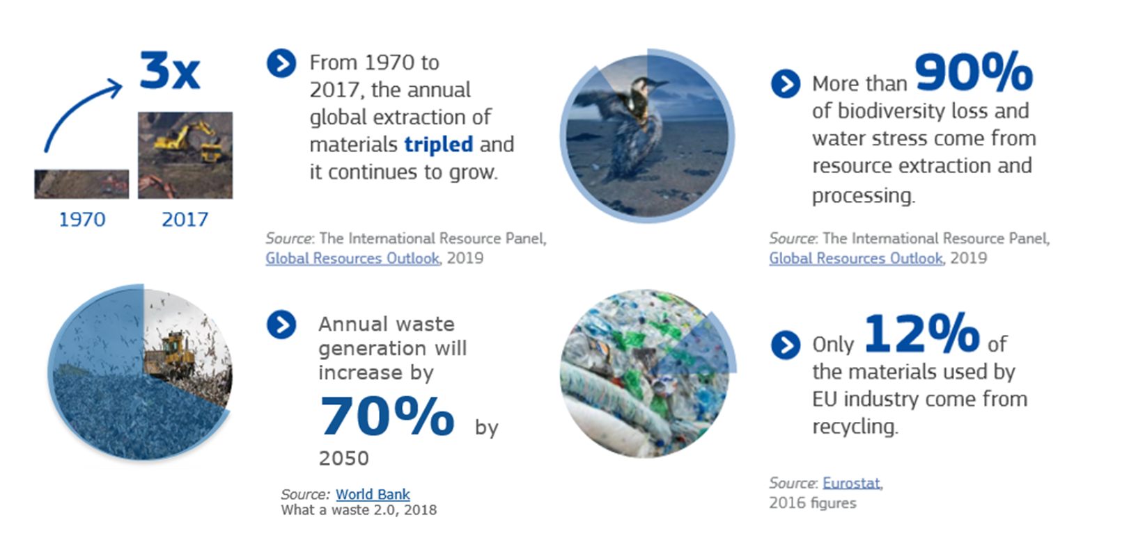
  CEAP - Need for action
There is only one planet Earth, yet by 2050, the world will be consuming as if there were three

Slide 5

A new Circular Economy Action Plan – March 2020
Make sustainable products the norm in the EU
Empower consumers and public buyers
Sustainable production processes
Making circular economy work for people, regions and cities
Sustainable
Product Policy Framework
Circular economy as a requisite for climate neutrality
Electronics and ICT
Batteries and vehicles
Packaging
Plastics
Textiles
Construction and buildings
Food, water and nutrients
Getting the Economics Right
Financial Markets
Key
Value
Chains
Less
Waste
More
Value
Investments and R&I
Global Level Playing Field
Reduce Waste
Reduce Waste Exports
Boost market for high quality and safe secondary raw materials
Monitoring

Slide 6
  Waste oils - Background
WFD Article 3(3) - “‘waste oils’ means any mineral or synthetic lubrication or industrial oils which have become unfit for the use for which they were originally intended, such as used combustion engine oils and gearbox oils, lubricating oils, oils for turbines and hydraulic oils;”
Article 21 of the WFD contains provisions defining obligations for separate collection of waste oils and favouring regeneration of waste oils over other treatments, including energy recovery.
Under Art. 21(4) the Commission has, by 31 December 2022, to examine data on waste oils provided by MSs …with a view of considering the feasibility of adopting measures for the treatment of waste oils … including quantitative targets on the regeneration of waste oils …and any further measures to promote regeneration. .. submit a report to the EP and Council accompanied, if appropriate by a legislative proposal.

Slide 7
  Waste Oils- In the beginning
Initially regulated by Council Directive 75/439/EEC
Required collection and disposal without causing avoidable damage to man and the environment
Required MSs to take measures to give priority to regeneration – where technical, economic and organisational constraints so allow. (from 1987 – Dir 87/101/EEC)
Prohibit any discharge into water or soil
Permitting of installations, requirement on base oil produced, PCB/PCT content, inspections, reporting etc…
Repealed as of 12 December 2010

Slide 8
  Waste oils in revised Dir. 2008/98/EC
Article 21 requires MSs to ensure that:
Waste oils are collected separately, unless separate collection is not technically feasible taking into account good practices
waste oils are treated, giving priority to regeneration or alternatively to other recycling operations delivering an equivalent or a better overall environmental outcome than regeneration, in accordance with Articles 4 and 13
waste oils of different characteristics are not mixed and waste oils are not mixed with other kinds of waste or substances, if such mixing impedes their regeneration or another recycling operation delivering an equivalent or a better overall environmental outcome than

Slide 9
  Waste oils in revised Dir. 2008/98/EC (II)
Under Article 35, MS are required to:
Establish an electronic registry or registries for receiving information reported on hazardous waste (and potentially other waste streams).
COM may define minimum conditions for these.
Under Article 37, MS are required to:
report the data, each year, starting for 2020, on:
  mineral or synthetic lubrication or industrial oils placed on the market
  On waste oils separately collected and treated for each calendar year to the Commission
  Report to be submitted electronically to COM 18 months after end of reporting year.

Slide 10
  Study on Waste Oils and Solvents (2018 – 2019)
In 2018 the COM engaged the technical assistance of Öko-Institut to:
  Develop reporting format for MSs reporting on waste oils
  Develop quality check report and guidance to MSs on use of format.
    → COM Implementing Decision(EU) 2019/1004 of 7 June 2019
  Generate data on production of lubricating oils and generation / collection and treatment of waste oils in MSs – to support COM’s Art 21(4) obligation, given first MS reporting not due till mid 2022.
  Additional similar prospective work on other hazardous liquid waste – waste solvents..
  “Study to support the Commission in gathering structured information and defining of reporting obligations on waste oils and other hazardous waste” published on 30 March 2020:
  https://op.europa.eu/en/publication-detail/-/publication/73a728bc-72f5-11ea-a07e-01aa75ed71a1/language-en/format-PDF/source-123020647

Slide 11
  Elements of the study
The study has provided insight into:
Amounts and types of industrial oils placed on the EU market (by country).
Amounts and types of waste oils collectable and collected and treated in the EU (by country).
Overview of EU lubricant and waste oil markets.
Amount of waste oils regenerated into base oils vs used for energy recovery (by country).
Description of collection practices and treatment technologies.
Inventory of treatment installations in the EU.
Description of best practices (in terms of separate collection, EPR schemes, national targets, etc).
Recommendations in terms of possible policy options to promote regeneration of waste oils.
Information on EoW criteria relevant to waste oils adopted at national level.

Slide 12
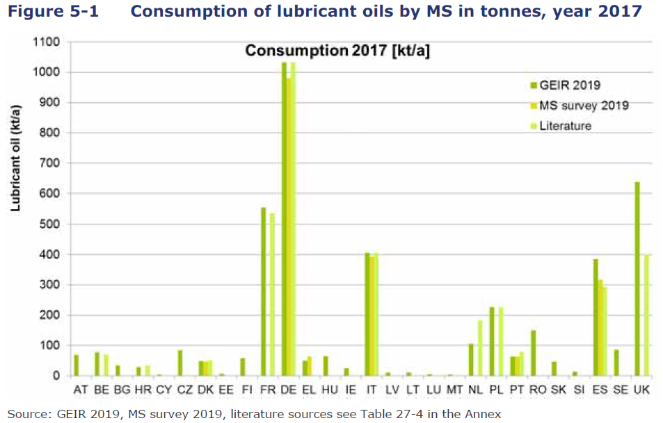
  Results of the study
Overall, about 38% of the lubricant oils placed on the market (4.3 Mt) in the EU-28 was collected as waste oil (1.6 Mt).
Collection rate of approximately 82% (of collectable oil)
About 1.6 Mt of waste oils treated in 2017: 61%, input to re-refineries resulted in about 0.68 Mt of re-refined base oil.
About 24% of total waste oil was treated to produce fuels and about 11% was used for energy recovery in cement, lime, steel and power plants.

Slide 13
  Conclusions of the study
Establishing quantitative collection targets is a key factor for increased collection. Collection targets together with extended producer responsibility (EPR) schemes present best practice examples on national level. Success depends on specific implementation.
Strict implementation of the waste management hierarchy is the key factor. The waste hierarchy prioritises the re-refining of waste oil over energy recovery.
To implement a clear priority for re-refining, setting quantitative targets for waste oil regeneration have been identified as a determining factor.
Enforcement of restrictions for the export of waste oil to incineration and co-incineration when there is no re-refinery.
There is some indication that end-of-waste criteria defining fuel products are a negative driver in promoting regeneration of waste oil to base oils.

Slide 14
  Further work – JRC Study (on-going)
A new study has launched with the JRC to support DG ENV in the impact assessment that will accompany a possible measure regarding waste oils.
To be integrated in a broader amendment of the Waste Framework Directive in 2023
Analysis of existing LCA studies on different treatment options. Life Cycle Analysis / Life Cycle Costing work being carried out by JRC.
Further analysis of environmental, social and economic impacts, including of setting quantitative targets for regeneration, as per Better Regulation Guidelines of the Commission.
JRC study scheduled to conclude in 2022.

Slide 15
  Main tasks – JRC study
Task A.1 - Review of literature and data collection
Task A.2 - Comparative analysis of regeneration versus energy recovery
Task A.3 - Elaboration of initial policy options
Task A.4 - Estimation of environmental, social and economic impacts of refined policy options
Task A.5 - Support to DG ENV in drafting the impact assessment report

Slide 16
  System boundary

Slide 17
  Comparative analysis of regeneration versus energy recovery
Waste oil generation vs energy recovery: assessment of environmental performance + selected social & economic indicators
Indicators chosen based on Task A.4, may include:
  GHG emissions
  Pollutant emissions
  Use of resources
  Employment considerations
  Economic indicators
Take into account existing legislation/policy as drivers:
  MARPOL for reduced S content for marine fuels
  Fuel consumption efficiency in vehicles

Slide 18

Thank you
Learn more here: https://ec.europa.eu/environment/circular-economy/index_en.htm
© European Union 2021
Unless otherwise noted the reuse of this presentation is authorised under the CC BY 4.0 license. For any use or reproduction of elements that are not owned by the EU, permission may need to be sought directly from the respective right holders.

